Slide 1
Thriving in a Matrix Organization
Beth Giesbrecht, P.M.P.
bgiesbrecht@unomaha.edu

Slide 2
Offered by:
NBDC is an outreach program of the University of Nebraska Omaha's College of Business. We work with businesses: instructing and mentoring in project management, leadership, and technology to help make each employee more productive.
Delivered by:
Beth Giesbrecht, Bachelor in Ed., P.M.P.
Projects: Intel PMO, Web sites, Volunteers in education
bgiesbrecht@unomaha.edu
Copyright© NBDC through the University of Nebraska at Omaha. All Rights Reserved.
Notes:
2
2

Slide 3
What is a matrix?
Notes:
Ask for some of them to report back out

Slide 4
What is a matrix?
Talk at your table – how would you define “matrix”?
Notes:
Ask for some of them to report back out

Slide 5
“A ‘mixed’ organizational form in which normal hierarchy is ‘overlaid’ by some form of lateral authority, influence or communication… there are usually two chains of command, one long functional lines and the other along project lines.”
Larson and Gobeli (1987)

Slide 6
“The biggest mistake people in matrix situations? Assuming they can’t do anything about it.”
Executive Coach

Slide 7
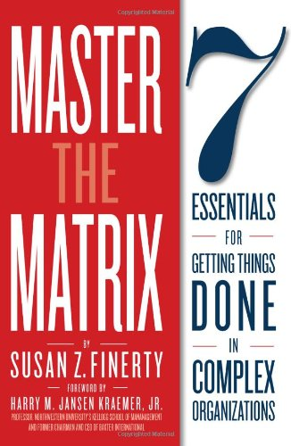

Slide 8
Matrix
Partnerships
Integrated
Collaborative
Goals aligned
Clear roles
Decisions made
Influence
Communicate
Meetings matter
Transactional
Dysfunctional
Start with
To get
All this requires you to
Source: Master the Matrix by Finerty

Slide 9
Partnerships
They don’t have to all be close
They could just be amiable

Slide 10
Matrix Essential 1: Partnerships
There are different levels of partnerships required in matrix organizations – depending on business need
What do those words mean to you?
New / Dysfunctional
Collaborative
Integrated
Transactional
Source: Master the Matrix by Finerty

Slide 11
Matrix Essential 1: Partnerships
Complete the Partners Worksheet on page 1 of your handout.
For one of those partnerships, complete the Do You Have the Right Fit assessment on page 2.
Any thoughts coming out of this partnerships section?
Source: Master the Matrix by Finerty

Slide 12
Matrix Working through the Essentials
We will split into 6 teams. Each team will be assigned a Matrix Essential:
Essential 2: Align Goals
Essential 3: Clarify Roles
Essential 4: Decisions
Essential 5: Influence
Essential 6: Communication
Essential 7: Meetings
Your assignment is to think through a work situation where this essential’s guidelines might be used or not used. It could be an actual situation or a fictional one. Be prepared to debrief your essential to the group.
Notes:
12

Slide 13
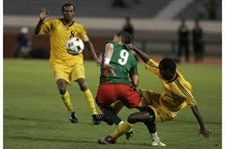
Matrix Essential 2: Align Goals
Include the right people | Land on a limited set of goals | Keep goals in the foreground | RESULTS
√ | √ | √ | GOAL ALIGNMENT
√ | √ |  | Distractions, Drifting
√ |  | √ | Diffused efforts
 | √ | √ | Stakeholder resistance
Source: Master the Matrix by Finerty

Slide 14
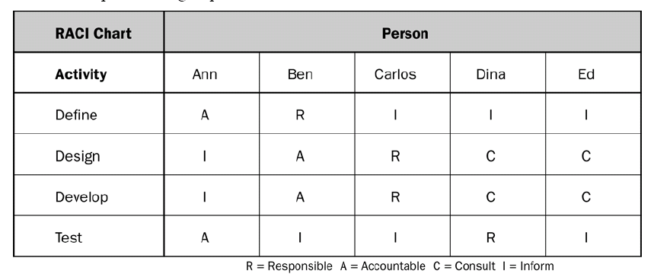
Matrix Essential 3: Clarify Roles

Slide 15
Matrix Essential 4: Getting Decisions Made
 | Traditional Roles/ Organization | Matrix Roles / Organization
Making the decision | Hierarchy/title driven Straightforward, linear Often behind closed doors, unstructured Often exclusive | Expertise, role, input-driven Complex, much back and forth Inclusive
Executing the decision | Authority-driven Communication on the “what” of the decision Requires little follow up | Ownership-driven Communication is transparent on what, why, how, and who Can require significant follow up
Key challenges | Making the right decision and using authority to implement | Balancing decision-making speed with inclusion Knowing who is the ultimate decision-maker Gaining ownership in the decision to make it “stick”
Source: Master the Matrix by Finerty

Slide 16
Matrix Essential 4: Getting Decisions Made
A structured, credible process | Include the right people in the right way | Consistent, transparent communication & follow up | YOUR DECISION IS LIKE TO BE:
√ | √ | √ | IMPLEMENTED AND INTEGRATED
 | √ | √ | Questioned
√ |  | √ | Overturned or ignored
√ | √ |  | Forgotten
Source: Master the Matrix by Finerty

Slide 17
Matrix Essential 5: Flex Your Influence Muscle
 | When You … | They …
Proactively | Forge meaningful partnerships | TRUST
 | vs. Attempt to form “Just in Time”
 | Establish a history of willingness to be influenced
 | vs. Hold steadfast
 | Do your homework and understand their perspective
 | vs. Assume you know
→
→
→
Source: Master the Matrix by Finerty

Slide 18
Matrix Essential 5: Flex Your Influence Muscle
 | When You … |  | They …
In the Moment | Frame the issue in a meaningful and objective way | Pay attention | ARE INFLUENCED
 | vs. From your own perspective
 | Include and engage them in a dialogue | Own
 | vs. Talk and tell
 | Work to keep them in the conversation | Stay open, listen
 | vs. Work to be heard
 | Summarize, synthesize, speak clearly and succinctly | Understand
 | vs. Overwhelm with complexity
→
→
→
→
→
→
→
→
Source: Master the Matrix by Finerty

Slide 19
Matrix Essential 6: Communicate without Assumptions
From the Get Go | Ask: What information can I share on an ongoing basis that would be helpful?
 | Ask: What is the best way to provide it?
In the Message | Tell: Here’s why I’m sharing this with you.
 | Tell: Here’s the information that is most important.
 | Ask: Was this information helpful?
 | Cc: Only those who really need to know, and let people know why they are cc’d.
Ongoing | Ask: Are you getting what you need from me? What information is most helpful? Least?
Source: Master the Matrix by Finerty

Slide 20
Matrix Essential 7: Treat Meetings Like They Matter
IF YOU DON’T … | YOU ARE TELLING PEOPLE …
… attempt to talk yourself out of having a meeting | “I like to meet for the sake of meeting. I’ve got nothing better to do, and I assume you don’t either.”
… get really clear on your outcomes Outcome verbs (resolve, decide, identify, create) NOT talk verbs (discuss, explore, share, confer) ... craft your agenda … invite and prepare the right people | “This meeting isn’t important enough (and your time isn’t important enough) for me to spend any time on it.”
… facilitate the heck out of it | “I’m not disciplined and won’t hold you to that standard.”
… follow up and hold accountable | “What we talked about was really important at the time, but not as important once we went back to the real world.”
→
→
→
→
Source: Master the Matrix by Finerty

Slide 21
Thank You !
Book give away
Beth Giesbrecht bgiesbrecht@unomaha.edu

