Slide 1
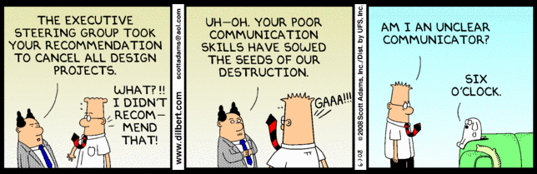
The One Page Project Manager
Beth Giesbrecht, P.M.P.
Nebraska Business Development Center – UNO – College of Business Administration
bgiesbrecht@unomaha.edu

Slide 2

Nebraska Business Development Center
UNO / College of Business Administration
Professional and Organizational Development
Small Business Administration (SBA)
Doing business with the government (PTAC)
Continuous Improvement / Lean (MEP)
Green Business / Energy Efficiency
Commercialization Innovation and Research (SBIR)
Veterans in business (VASP)
Offices in: Auburn ~ Chadron ~ Grand Island ~ Kearney ~ Lincoln ~ Norfolk ~ North Platte ~ Omaha ~ Scottsbluff ~ Wayne

Slide 3

Visual Communication
Our tendency is to written or verbal communication, but remember that a picture is worth a thousand words.

Slide 4
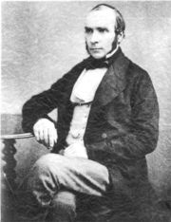
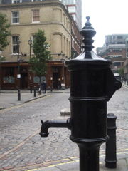
Snow and cholera epidemic
London - 1854
Science at the time thought cholera air born.
Within 3 days, 83 deaths.
Dr. Snow thought the cause contaminated water.
Notes:
Illustrates the Power of Visuals

Slide 5
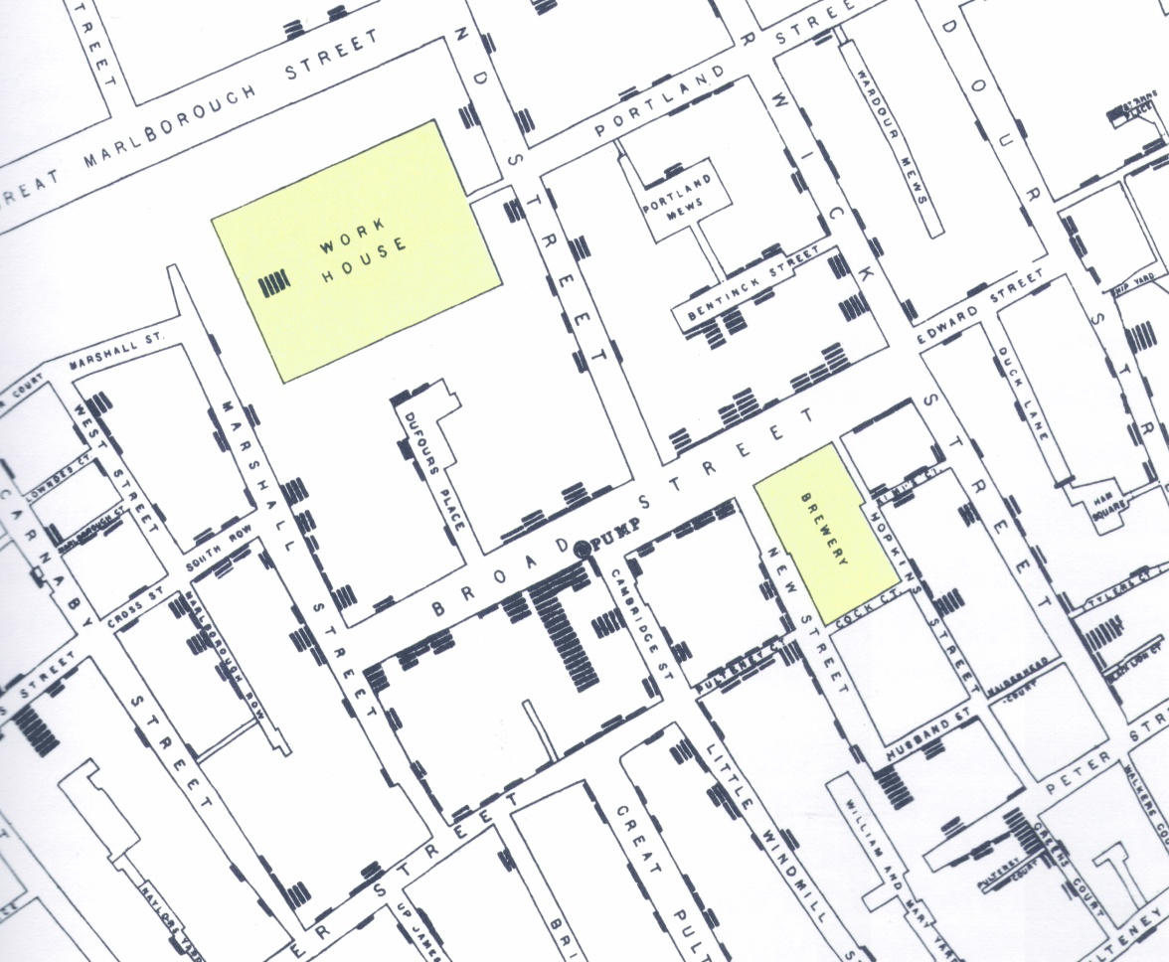
Snow’s map of London

Slide 6
Snow and cholera epidemic
London - 1854
He used a visual tool to not only help him in his research but to communicate the idea to those in power, who could do something about it.

Slide 7
Controls vs. Displays
A visual display relates information and data to employees in the area. For example, charts showing the monthly revenues of the company or a graphic depicting a certain type of quality issue that group members should be aware of.
A visual control is intended to actually control or guide the action of the group members. Examples of controls are readily apparent in society: stop signs, handicap parking signs, no smoking signs, etc.
www.mamtc.com

Slide 8

Visibility Objectives
Determine activity
Communicate
Verify status
Determine and influence morale and team spirit
Forsberg, Mooz, and Cotterman: Visualizing Project Management

Slide 9

Basic Assumptions
Visual monitoring tools might be part of a new way to manage the project and thus involve change.
Visuals are important because they enforce a disciplined focus and adherence to the process.
Nebraska MEP/Lean

Slide 10
Where the One Page Project Manager came from
Toyota A3 report
  A3 = metric sized piece of paper – close to 11”x17”
Probably originated at Hewlett-Packard in the 1970s
Clark A. Campbell, The One-Page Project Manager

Slide 11
The One Page Project Manager
Goal: to communicate aspects of the project to those that are not part of the project
We want just the right degree of the absence of precision
Does not replace existing tools but augments what you’re already using
Customizable
Clark A. Campbell, The One-Page Project Manager

Slide 12
Header
Project Name
Project Manager
Project Objective
Clark A. Campbell, The One-Page Project Manager

Slide 13
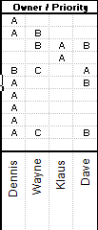
Owners
Each task should be assigned to be overseen by at least one person.
There may be a task with an A Owner and a B owner.
Clark A. Campbell, The One-Page Project Manager

Slide 14
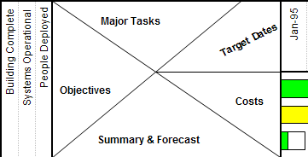
Corner Matrix / Compass
In the bottom left corner, there is a matrix that guides you to those items in the rest of the page.
Clark A. Campbell, The One-Page Project Manager

Slide 15
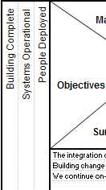
Objectives
Why are we doing these tasks? Hopefully, each task is helping us toward an objective.
Clark A. Campbell, The One-Page Project Manager
Notes:
No more than 3-4 per project
How much time will be needed to complete the various objectives?
What resources will be needed?
Want a fairly level distribution of tasks per objective
SMART – Simple, Measurable, Attainable, Relevant, Time based

Slide 16
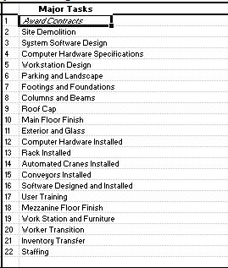
Major Tasks
Maybe 30 for a 12 month project
Larger projects would show just the major tasks here – there might be a one page manager for each of these tasks
Clark A. Campbell, The One-Page Project Manager
Notes:
Match tasks with the strengths of the owners
Average 2-3 tasks per reporting period

Slide 17
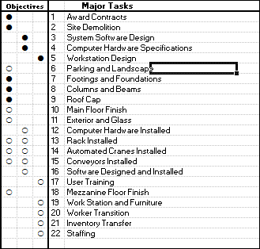
Align tasks with objectives
If there is no alignment between task and objectives, why are we doing it?
A task may align with multiple objectives
Might reveal missing items
Clark A. Campbell, The One-Page Project Manager

Slide 18

Target dates
Most commonly monthly but for a short project could be weekly or bi-weekly
When you let everyone know the project’s timeline and time increments, you magnify your responsibility to meet them
Clark A. Campbell, The One-Page Project Manager

Slide 19
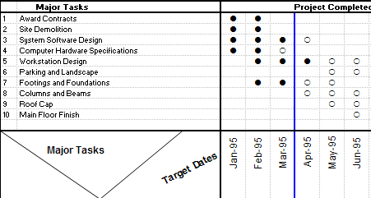
Align tasks to the timeline
Open circles – scheduled
Filled in circles - completed
Clark A. Campbell, The One-Page Project Manager

Slide 20
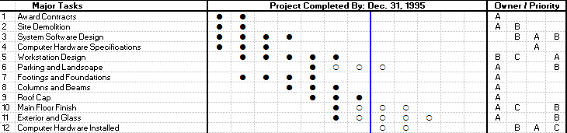
Align tasks to owners
Often one owner, never more than three
Always one main owner - A
Clark A. Campbell, The One-Page Project Manager

Slide 21

Subjective Tasks
There are parts of every project that don’t fit easily into quantitative analysis on a timeline.
Still align to owners
Judgment concerning performance – green, yellow, red
Clark A. Campbell, The One-Page Project Manager
Notes:
Qualitative – good place to show Earned Value

Slide 22
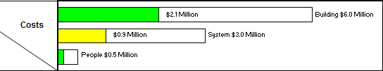
Costs
Green – on budget
Yellow – over but recoverable
Red – incurably over budget
Clark A. Campbell, The One-Page Project Manager
Notes:
Display is easy – deriving it much more difficult

Slide 23
Summary and Forecast
Needed to clear up any ambiguities, questions and heads off any potential misunderstandings.
The summary should be about why. And what you are going to do about it, what you expect to happen.
Clark A. Campbell, The One-Page Project Manager

Slide 24
Creating Reports
Mark your current status date
Fill in major task progress – fill in the dots
Designate qualitative performance
Report expenditures
Write the summary and forecast
Clark A. Campbell, The One-Page Project Manager

Slide 25
Lights at the End of the Tunnel
A long auto tunnel through the mountains above Lake Geneva has just been completed.
Just before opening, the chief engineer remembered that she forgot to warn motorists to turn on their lights before entering the tunnel.
She created a simple sign:
WARNING: TUNNEL AHEAD
PLEASE TURN YOUR HEADLIGHTS ON
Gause & Weinberg

Slide 26


The Problem at the End of the Tunnel
At the end of the tunnel is a breathtakingly beautiful scenic rest stop.
People accidentally left their car lights on and came back to their cars with dead batteries.
Many complaints.
Law enforcement time being wasted jump starting.
Gause & Weinberg

Slide 27
A Masterpiece of Swiss Precision
IF IT IS DAYLIGHT AND IF YOUR LIGHTS ARE ON, TURN OFF YOUR LIGHTS.
IF IT IS DARK, AND YOUR LIGHTS ARE OFF,
TURN YOUR LIGHTS ON.
IF IT IS DAYLIGHT, AND YOUR LIGHTS ARE OFF, LEAVE YOUR LIGHTS OFF.
IF IT IS DARK, AND IF YOUR LIGHTS ARE ON, LEAVE YOUR LIGHTS ON.
Gause & Weinberg

Slide 28

Keep it as simple as possible
ARE YOUR LIGHTS ON?
Gause & Weinberg

Slide 29
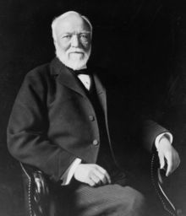
The Big Chart
The Big Chart has a humble yet venerable history in the business world.
One day, as Andrew Carnegie toured his iron works, he passed a smelter and asked how many pigs of iron had been poured there the day before. He then picked up a piece of coal and wrote that number on the wall.
The next day, as he passed by the same furnace, the number had been crossed out, and a larger one written in its place. The workers at the furnace, seeing their work displayed in this public way, were naturally inclined to work a little harder the next day. And each day after, they strove to keep the number moving upwards.

Slide 30

The Big Chart
It is about more than just tracking — it is about displaying the results where everyone can see them, every day.
It's a natural consequence that people will have the desire to increase their scores, to speed up the progress and increase the measure of their work.
James Hartnett, Projects@Work

Slide 31

The Big Chart
Make sure that you are measuring something that you really want, not just a side effect of what you really want.
  Bugs in the code
  Lines of code
When you put up a chart, you automatically motivate people to perform well by the measure it represents.
Ask at a staff meeting what would be appropriate to measure at this stage in the project, and there will probably be plenty of good ideas.
James Hartnett, Projects@Work
Notes:
They don’t measure Number of Accidents but Days without an Accident

Slide 32
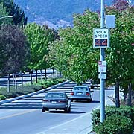
What’s the problem?
Notes:
In AZ the state put radar controlled speed signs ("You are going XX MPH") along the remote highways. The weekly printout of max speeds showed no reduction in speed, only increases. The drivers with muscle cars were using the stretch of road as a calibrated way to know how fast they could go.

Slide 33
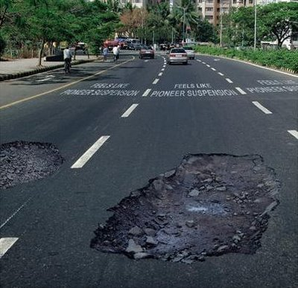
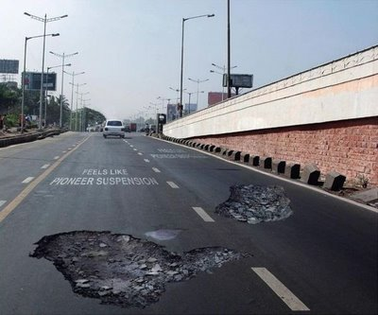
Would this slow you down?

Slide 34
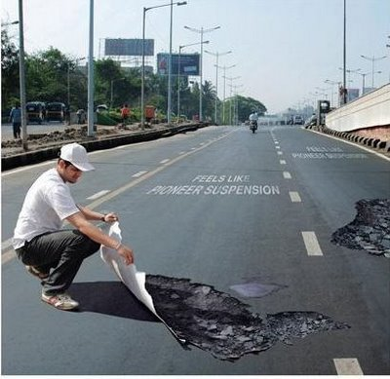
Would this slow you down?

